Slide 1
HAWKES LEARNING
Preparing to Write a Longer Text

Slide 2
Preparing to Write a Longer Text
Academic Writing Process
Writing Schedule

Slide 3
Writing Process
Pre-writing
Drafting
Revising
Publishing

Slide 4
Writing Process
Pre-writing
Drafting
Revising
Publishing

Slide 5

Writing Process
Pre-writing
Drafting
Revising
Publishing

Slide 6
Pre-writing
Planning
&
Organizing

Slide 7
Pre-writing
Determine genre and purpose
Choose a topic and narrow scope
Write a statement
Organize and outline

Slide 8

Pre-writing
Determine genre and purpose
Choose a topic and narrow scope
Write a statement
Organize and outline

Slide 9
Pre-writing
Determine genre and purpose
Choose a topic and narrow scope
Write a statement
Organize and outline

Slide 10
Pre-writing
Determine genre and purpose
Choose a topic and narrow scope
Write a statement
Organize and outline

Slide 11
Pre-writing
Determine genre and purpose
Choose a topic and narrow scope
Write a statement
Organize and outline

Slide 12
Drafting
➔
Words on paper
Uses words to show why and how such as “as a result, because, cause, due to, effect, therefore, or since.”
HAWKES LEARNING

Slide 13
Drafting
➔
Words on paper
➔
Strong paragraph organization
Uses words to show why and how such as “as a result, because, cause, due to, effect, therefore, or since.”
HAWKES LEARNING

Slide 14
Drafting
➔
Words on paper
➔
Strong paragraph organization
Uses words to show why and how such as “as a result, because, cause, due to, effect, therefore, or since.”
➔
Good topic sentences
HAWKES LEARNING

Slide 15
Revision
improvements to organization and content
HAWKES LEARNING

Slide 16
Revision
improvements to organization and content
Global
Learner
Sequential Learner
HAWKES LEARNING

Slide 17
Revision
Global Learner
Sequential Learner
Expressing the big idea
or
Checking individual paragraphs
HAWKES LEARNING

Slide 18
Revision
improvements to organization and content
check grammar and assess style
HAWKES LEARNING

Slide 19
Publishing
Layout
Design
Format

Slide 20
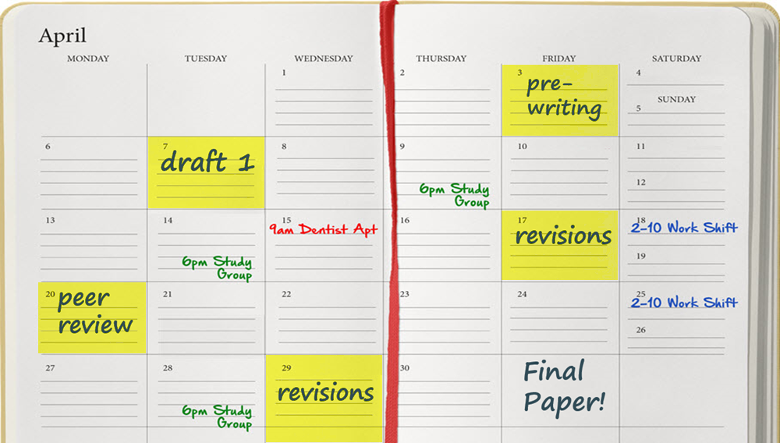
Writing Schedule

Slide 21
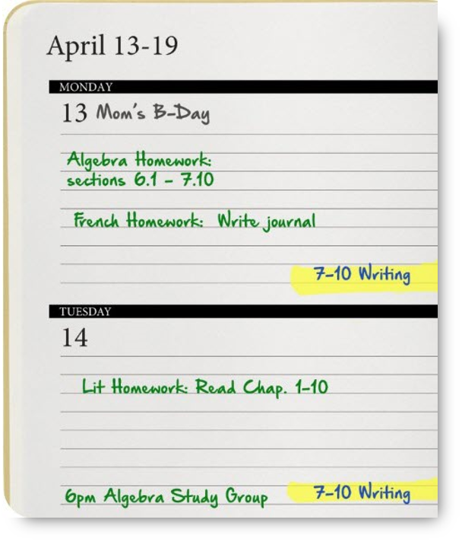
Writing Time

Slide 22
Writing Schedule
!
Leave an extra day for publishing
!
Never wait until the last minute
HAWKES LEARNING

Slide 23


